Slide 1
Glycoprotein Builder Genetic Algorithm
Gordon Chalmers
Department of Computer Science
Complex Carbohydrate Research Center

Slide 2
Problem Addressed
Two angles, chi1 and chi2, are used to orient the attached glycan.
These glycans could be oriented in a way that they intersect with the protein or other nearby glycans. This is physically unacceptable.
The problem : re-orient the glycans by changing the chi1, chi2 angles.
Goal is < .1 overlap for each glycan

Slide 3
Search space
If there are N glycans, then there are 2N angles.
These angles can range from [-180,180] for chi2, and [-30,30], [30,90], [150,210] for chi1, heuristically, but not the case in reality
The complexity is approximately 360^(2N) ~ 10^(4N)
HIV gp120 and gp160 are used as examples, N=26, N=78
10^(4N) \approx. 10^312 large space of possible angles
Can deal with search spaces of 10^1000

Slide 4
2 approaches
Monte Carlo
Genetic algorithm
Advantages : MC is fast, genetic algorithm has a better search
Disadvantages : MC doesn’t search enough, MC also potentially deletes sites, genetic algorithm is slow
These approaches will be compared.

Slide 5
Bead Approximation
The calculations can be made faster if the protein is covered with ‘beads’
Each bead radius is 3 A
Intersection of beads is the overlap
-- if overlap is zero then actual overlap is zero
-- calculation is not as accurate
-- even if the total overlap is not zero, the actual overlap could be zero
Images of calculation next

Slide 6
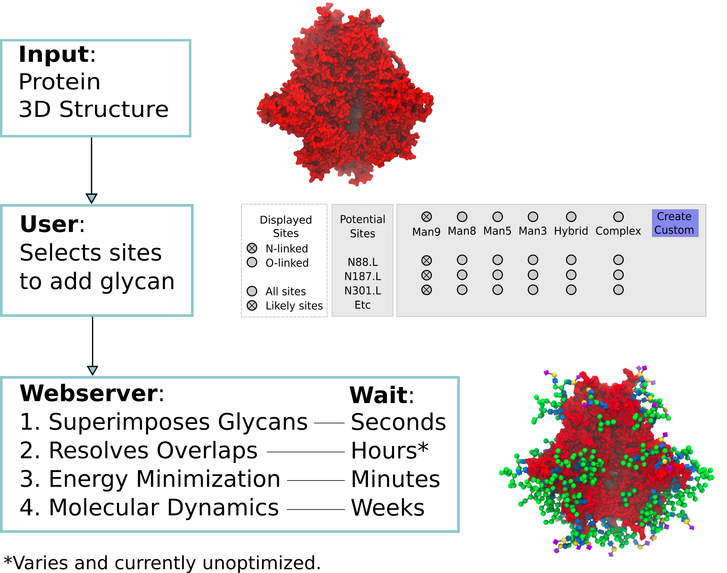
Bead approximation

Slide 7
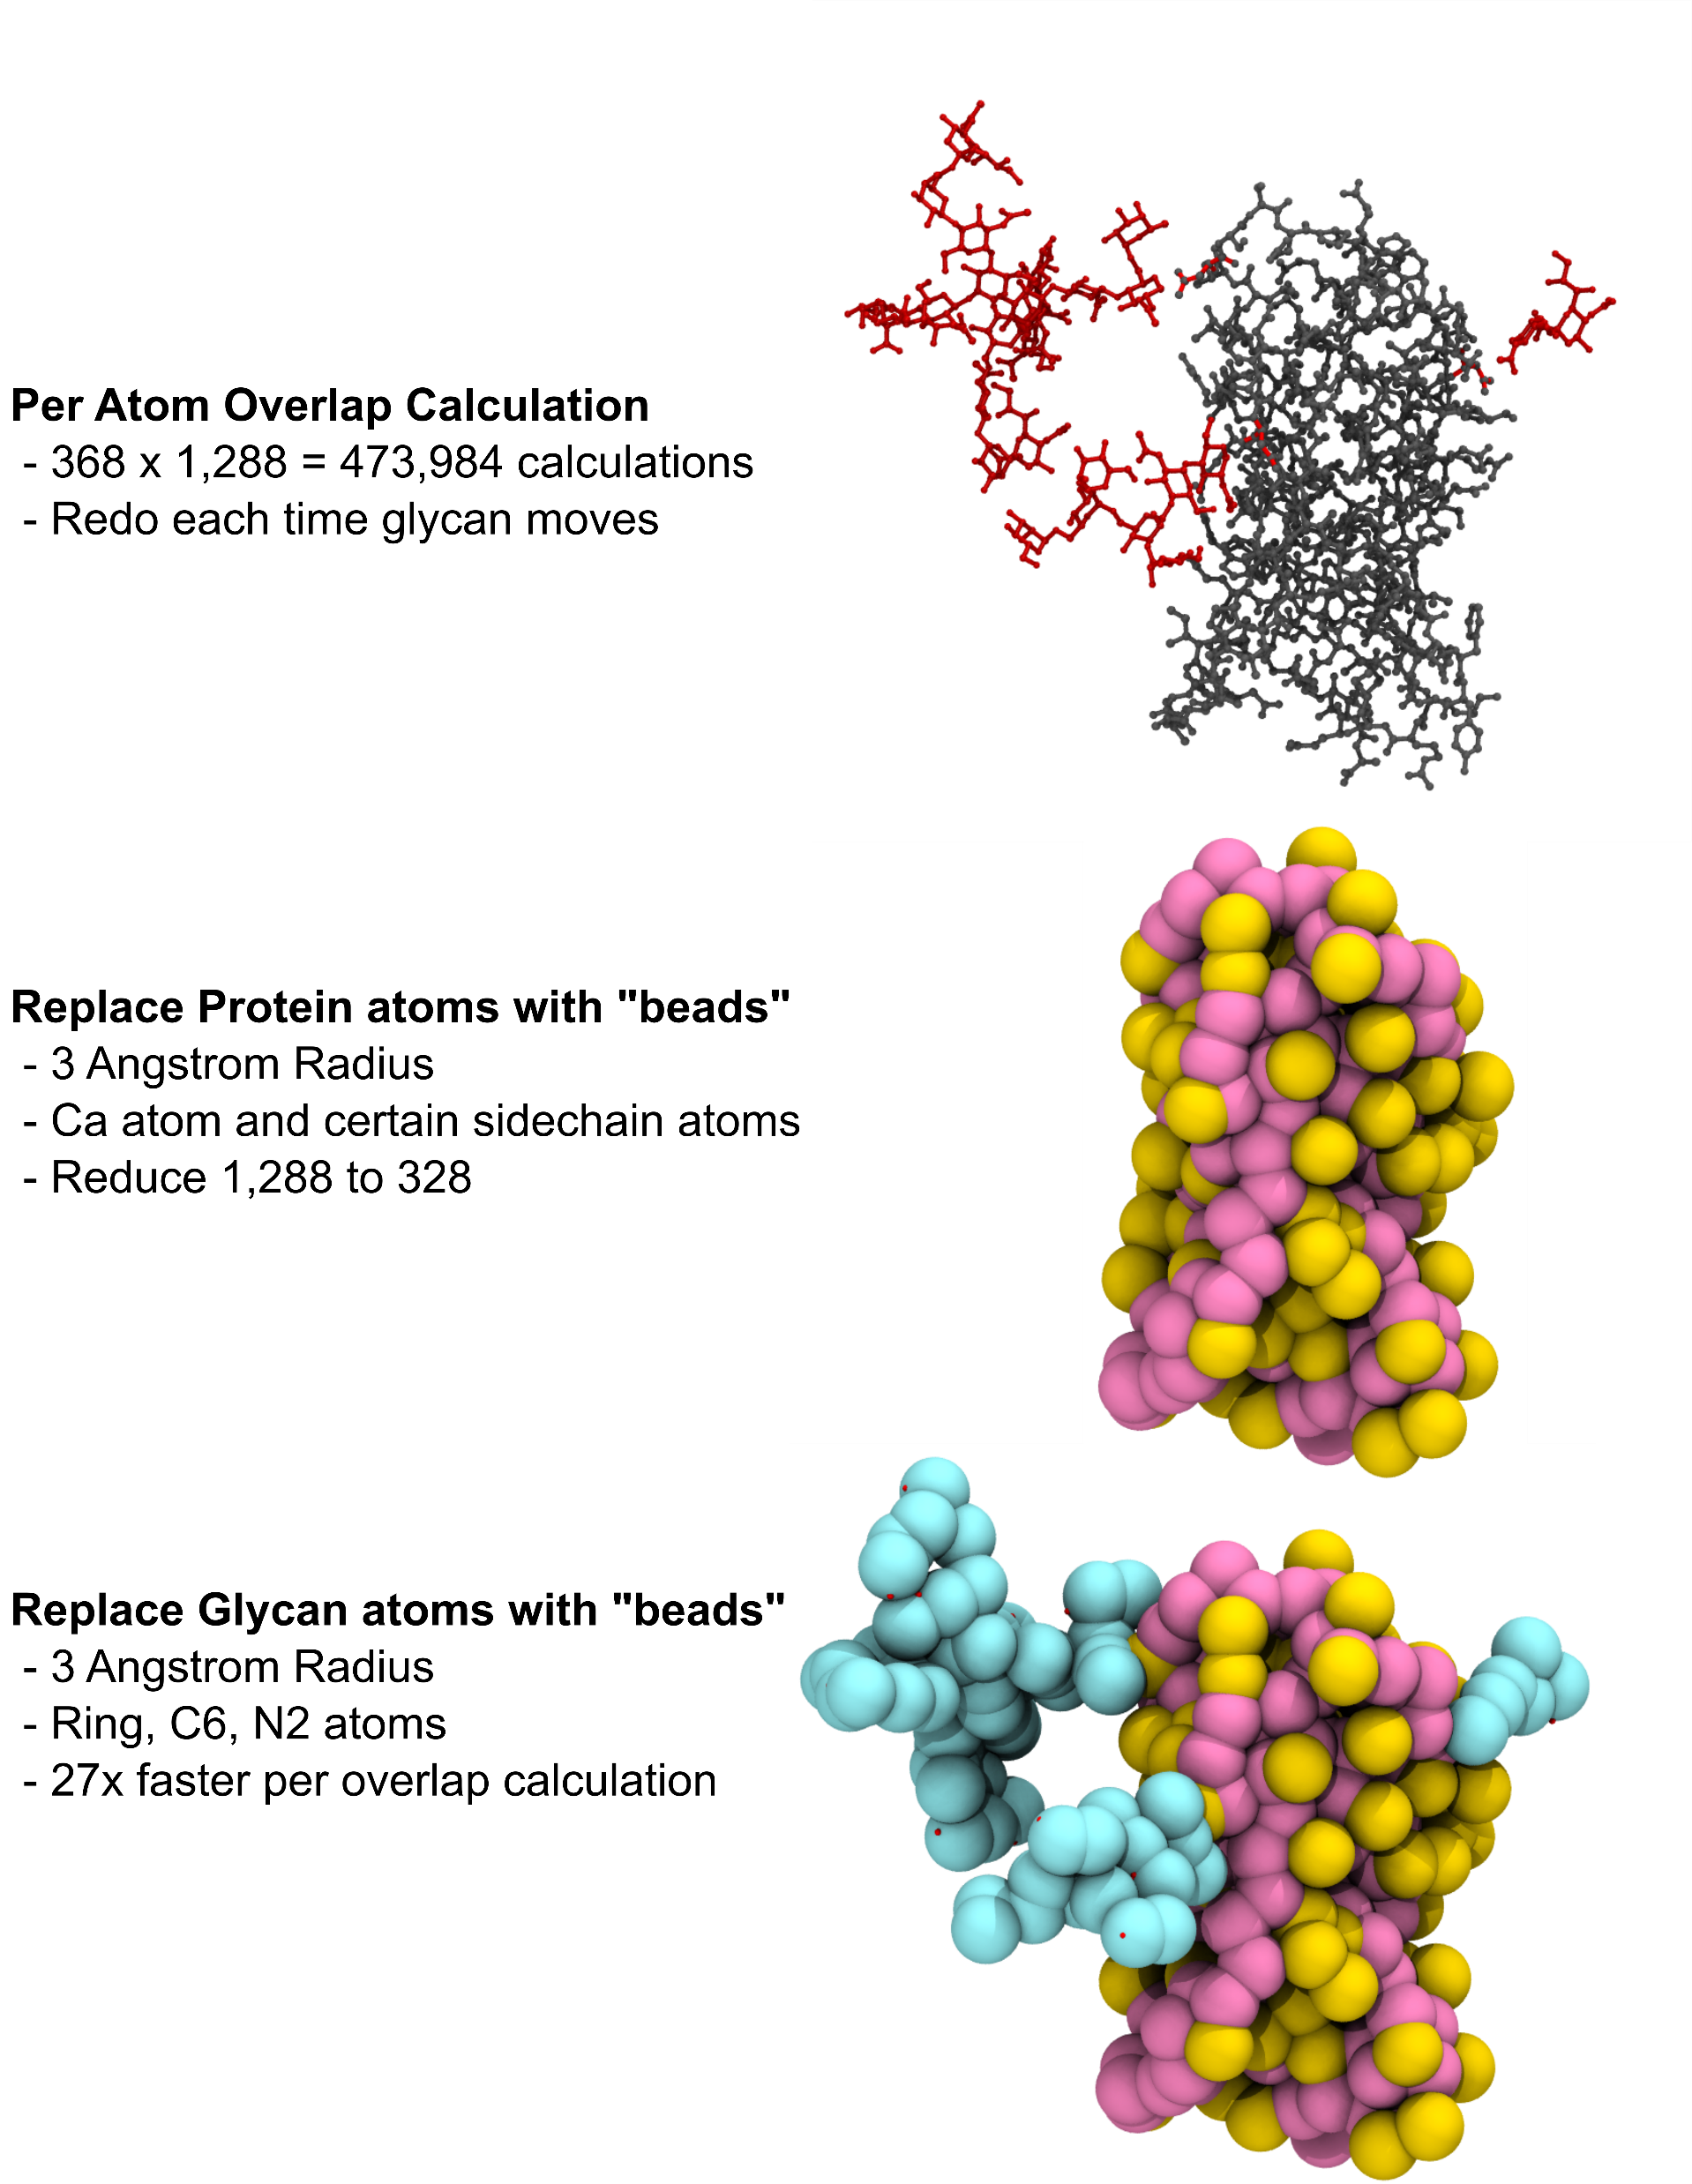

Slide 8
Monte Carlo
/* Algorithm overview:
Resolve all protein overlap first, reject sites that cannot be resolved.
Calculate protein overlaps, for each site with overlaps
Change chi1 and chi2 values, record values that reduce overlaps
Once finished delete any sites that could not be resolved
Calculate total (protein+glycan) overlaps, for each site with overlaps
Change chi1 and chi2 values, record values that reduce overlaps
Once finished delete any sites that could not be resolved */

Slide 9
Genetic algorithm
Uses population of chromosomes, i.e. individuals
Crossover/mutation of the population chromosome information
Evolves population until a ‘good fitness’ is found
I have used GA’s in C++ and in Matlab
Matlab is very good – some restrictions with integer information

Slide 10
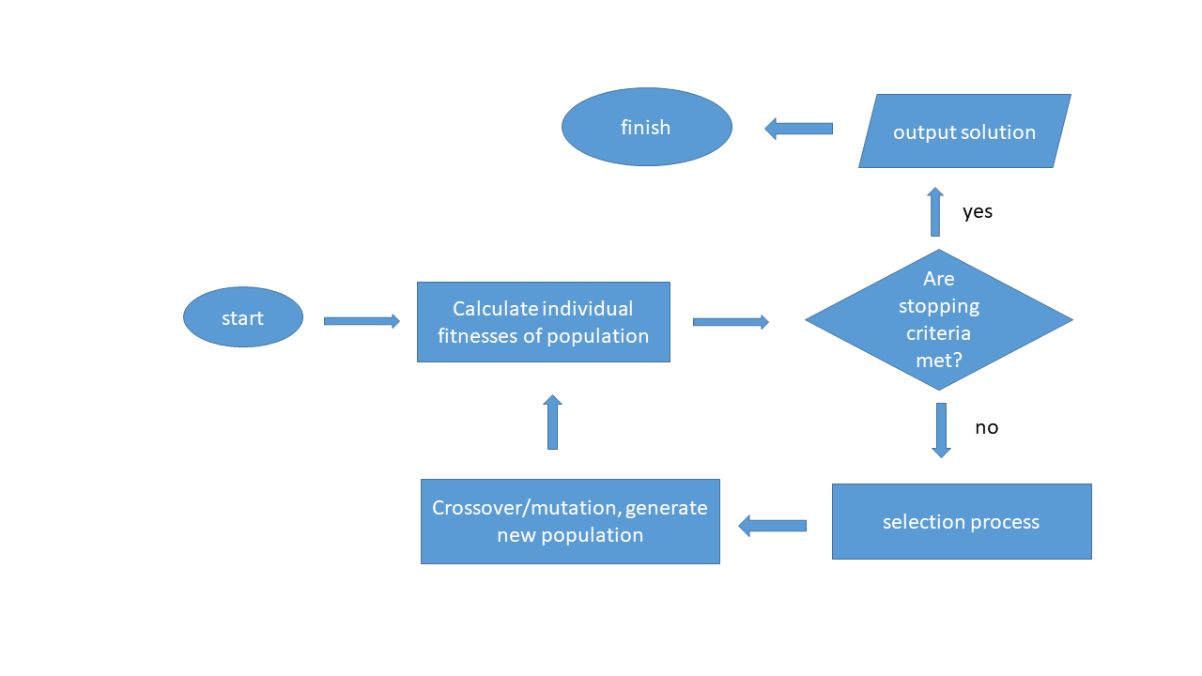
-- Could take many iterations
-- Takes time to complete
Flow of genetic algorithm

Slide 11
Advantages/Disadvantages
Disadvantages
genetic algorithm is slow
has to be tuned, which can be difficult
Advantages
can be used effectively if search space is very large, e.g. 10^1000
accurate for approximating NP-hard problems

Slide 12
Genetic GlycoProteinBuilder
2N chi1, chi2 angles
Chromosome has 2N alleles,
Each genetic algorithm problem requires its own crossover and mutation function
This genetic algorithm is unusual in that the usual single point crossover and mutation has little effect

Slide 13
Crossover, Mutation
Crossover for this chromosome only changes the total overlap of from genes at the crossover point
Single point is used, crossover is performed several times to change the chromosome and total overlap
this is like mutation
Mutation is quite different from typical functions
at each glycan site the angles are scanned for the minimal overlap
this really is not mutation, it is more like crossover

Slide 14
Very potent mix of crossover and mutation
Mutation function optimizes angle orientation
Crossover function mixes the chromosomes
Uncommon : population convergence is fast
Does produce good results without deleting sites
Advantage : good results
Disadvantage : time consuming
This problem is unique. Should increase diversity in population?

Slide 15
Parameters
#define POPSIZE 4 population
#define MAXGENS 4 maximum iterations
#define NVARS 156 number of angles
#define PXOVER 0.9 crossover rate
#define PMUTATION 1.0 mutation rate
#define minimum_fitness 1.0 minimum site overlap for crossover/mutation
#define angle_change 5.0 angle change
#define elite_factor 0.1 elitism fraction .1 of population
const int NUM_THREADS = 20; 20 threads
#define NUMBER_CROSSOVERS 3 # of crossovers
Population is small, # iterations is small
mutation rate = 1.0
extremely small population and limit of iterations
pthreading is the solution to the small population and iterations

Slide 16
Parameters again
Would like angle change to be smaller
4 degrees is better than 5 degrees for resolution
Would like larger population, perhaps
The problem : the mutation, crossover is unique to genetic algorithms – angle change is most important
Computationally expensive to use ‘small’ parameters

Slide 17
Tuning
Parameters have to be changed
This could in principle be protein dependent, as seen in work with Professor Prestegard about peak intensity matching
There is a way to avoid tuning, however it is computationally expensive
Hours -> days

Slide 18
2 examples involving HIV
monomer of HIV gp120
HIV gp160
gp120 monomer Monte Carlo 1 minute, genetic algorithm 8 hours
overlap 17 overlap 10
many sites deleted no sites deleted
gp160 Monte Carlo – cant do , genetic algorithm <10 hours
overlap 41
no sites deleted

Slide 19
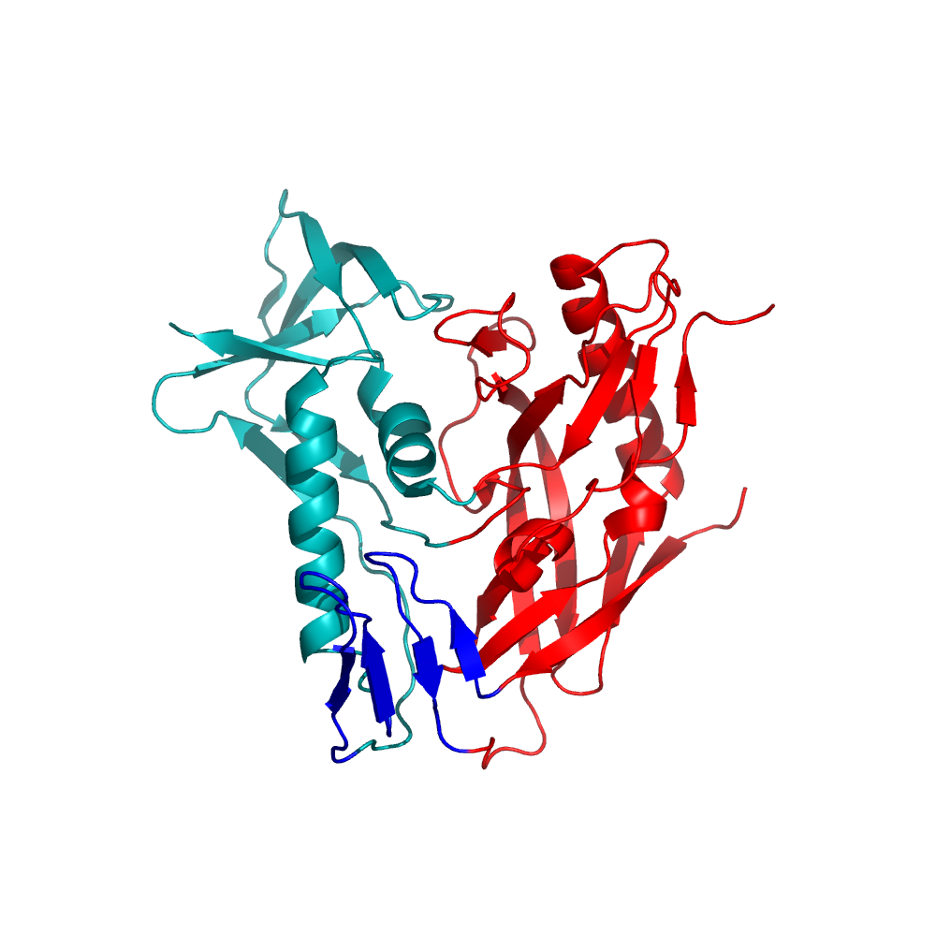
HIV gp160 trimer
78 glycans are attached
The large number is what makes this object invasive and hard to deal with.

Slide 20
Image with glycans

Slide 21
Example – HIV gp120 monomer
Output of program has overlap, generation number, seconds -> 8.02 hours
3 -10.3828 -10.3828 0.000732922 28877
iteration best average std time
Population converged in this case
Very slow, however, very good – no sites are deleted
Angles of the glycans are in the output, at each iteration, and the final result
To check, this is glycan 1
check_population_gene[0]=-140
check_population_gene[1]=-32

Slide 22
Test : chi1 and chi2 angles
Chi1 should be 60, -60, 180 +/- 30 heuristically
This is the case in the calculations, maybe +/- 40 is better
Chi2 can be any angle

Slide 23
8 hours for 26 glycans?
Genetic algorithms are known to be slow
26 glycans and 78 glycans are unusual
Mutation function is unusual
Good results, however time expensive
Pthreading will help, if users have the capability
Different mutation function?, maybe/maybenot

Slide 24
Discussion
2 programs to re-orient the glycosolation.
Monte Carlo – very fast, but it deletes sites
Genetic algorithm – very slow, but it does not delete sites and produces better results
Pthreading soon – important for better time of calculation, in progress
Tuning is still in progress, ok now

Slide 25
Glycam
Monte Carlo and Genetic will be in Glycam
Option to choose either one
Still some improvements to be made in genetic algorithm

Slide 26
Contributors
Oliver Grant
Rob Woods

